Slide 1
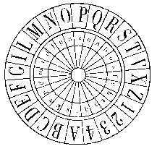
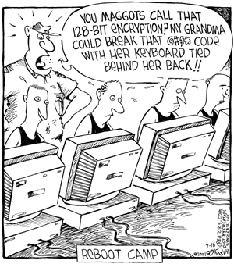
Classical Encryption Techniques (Chapter 2)
Dr. Arshad Farhad

Slide 2
Cryptography
Comes from Greek kryptós "hidden" and gráfein "to write"
The principles and methods of transforming an intelligible message into one that is unintelligible and retransforming that message to its original form at the other end.

Slide 3
Some Basic Terminology
plaintext - original message
ciphertext - coded message
cipher - algorithm for transforming plaintext to ciphertext
key - info used in cipher known only to sender/receiver
encipher (encrypt) - converting plaintext to ciphertext
decipher (decrypt) - recovering ciphertext from plaintext
cryptography - study of encryption principles/methods
cryptanalysis (codebreaking) - study of principles/ methods of deciphering ciphertext without knowing key
cryptology - field of both cryptography and cryptanalysis

Slide 4
Ciphers
Symmetric cipher: same key used for encryption and decryption
Block cipher: encrypts a block of plaintext at a time (typically 64 or 128 bits)
Stream cipher: encrypts data one bit or one byte at a time
Asymmetric cipher: different keys used for encryption and decryption

Slide 5
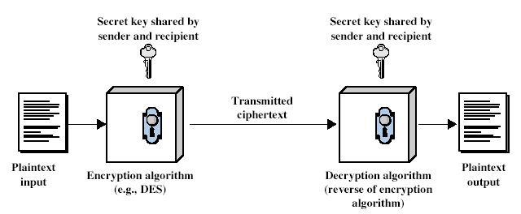
Symmetric Cipher Model

Slide 6
Symmetric Encryption
or conventional / secret-key / single-key
sender and recipient share a common key
all classical encryption algorithms are symmetric
The only type of ciphers prior to the invention of asymmetric-key ciphers in 1970’s
by far most widely used

Slide 7
Symmetric Encryption
Mathematically:
Y = E_{K}(X) or Y = E(K, X)
X = D_{K}(Y) or X = D(K, Y)
X = plaintext
Y = ciphertext
K = secret key
E = encryption algorithm
D = decryption algorithm
Both E and D are known to public

Slide 8
Cryptography
characterize cryptographic system by:
type of encryption operations used
substitution / transposition / product
number of keys used
single-key or private / two-key or public
way in which plaintext is processed
block / stream

Slide 9
Classical encryption operations
Plaintext is viewed as a sequence of elements (e.g., bits or characters)
Substitution cipher: replacing each element of the plaintext with another element.
Transposition (or permutation) cipher: rearranging the order of the elements of the plaintext.
Product cipher: using multiple stages of substitutions and transpositions
Notes:
a substitution cipher is a method of encoding by which units of plaintext are replaced with ciphertext, according to a regular system; the "units" may be single letters (the most common), pairs of letters, triplets of letters, mixtures of the above, and so forth. The receiver deciphers the text by performing an inverse substitution.
In a transposition cipher, the units of the plaintext are rearranged in a different and usually quite complex order, but the units themselves are left unchanged. By contrast, in a substitution cipher, the units of the plaintext are retained in the same sequence in the ciphertext, but the units themselves are altered.

Slide 10
Cryptanalysis
Objective: to recover the plaintext of a ciphertext or, more typically, to recover the secret key.
Two general approaches:
brute-force attack
non-brute-force attack (cryptanalytic attack)

Slide 11
Brute-Force Attack
Try every key to decipher the ciphertext.
On average, need to try half of all possible keys
Time needed proportional to size of key space
Key Size (bits) | Number of Alternative Keys | Time required at 1 decryption/µs | Time required at 10⁶ decryptions/µs
32 | 2³² = 4.3 × 10⁹ | 2³¹ µs = 35.8 minutes | 2.15 milliseconds
56 | 2⁵⁶ = 7.2 × 10¹⁶ | 2⁵⁵ µs = 1142 years | 10.01 hours
128 | 2¹²⁸ = 3.4 × 10³⁸ | 2¹²⁷ µs = 5.4 × 10²⁴ years | 5.4 × 10¹⁸ years
168 | 2¹⁶⁸ = 3.7 × 10⁵⁰ | 2¹⁶⁷ µs = 5.9 × 10³⁶ years | 5.9 × 10³⁰ years
26 characters (permutation) | 26! = 4 × 10²⁶ | 2 × 10²⁶ µs = 6.4 × 10¹² years | 6.4 × 10⁶ years

Slide 12
Cryptography - recap
characterize cryptographic system by:
type of encryption operations used
substitution / transposition / product
number of keys used
single-key or private : symmetric
two-key or public : Asymmetric
way in which plaintext is processed
block / stream

Slide 13
When Encryption is Secure?
Unconditionally Secure
An encryption scheme is unconditionally secure if the ciphertext generated by the scheme does not contain enough information to determine uniquely the corresponding plaintext, no matter how much ciphertext is available
Computationally Secure
The cost of breaking the cipher exceeds the value of the encrypted information.
The time required to break the cipher exceeds the useful lifetime of the
information.

Slide 14
Classical Substitution Ciphers
Letters/bits of plaintext are replaced by other letters/bits.
Categorized as:
Monoalphabetic Ciphers – Simple Cipher
Homophonic Ciphers (Multiple Substitutions)
Polyalphabetic Ciphers
Polygram Ciphers

Slide 15
Mono-alphabetic cipher/ Simple Substitution
Substitution of single letters separately
simple substitution—can be demonstrated by writing out the alphabet in some order to represent the substitution.
This is termed a substitution alphabet.
The cipher alphabet may be shifted or reversed (creating the Caesar and Atbash ciphers, respectively) or scrambled in a more complex fashion, in which case it is called a mixed alphabet or deranged alphabet.

Slide 16
Caesar Cipher
Earliest known substitution cipher
Invented by Julius Caesar
Each letter is replaced by the letter three positions further down the alphabet.
Plain: a b c d e f g h i j k l m n o p q r s t u v w x y z
Cipher: D E F G H I J K L M N O P Q R S T U V W X Y Z A B C
Example: Attack → Dwwdfn

Slide 17
Cryptanalysis of Caesar Cipher
Key space: {0, 1, ..., 25}
Vulnerable to brute-force attacks.
Need to recognize it when have the plaintext
What if the plaintext is written in Korean or …?

Slide 18
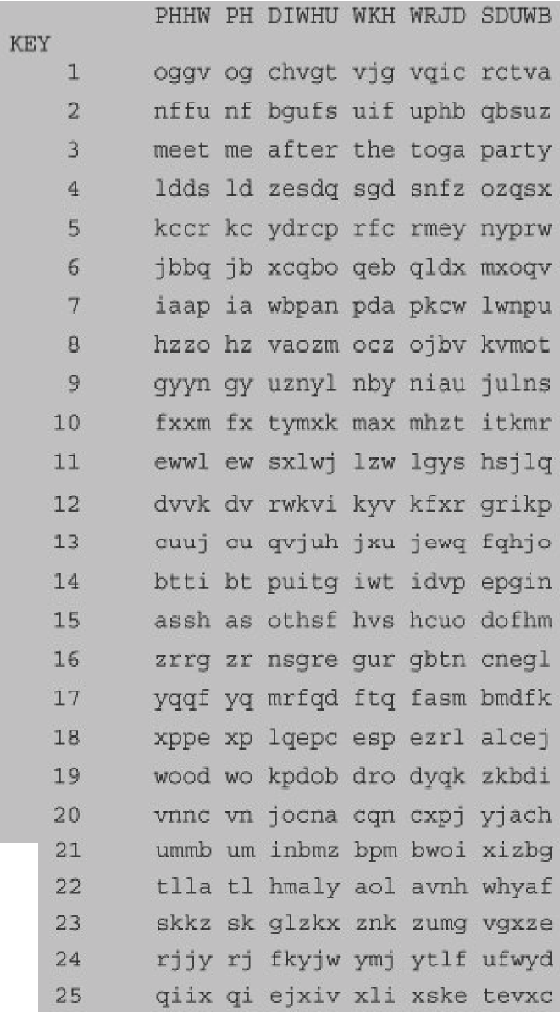
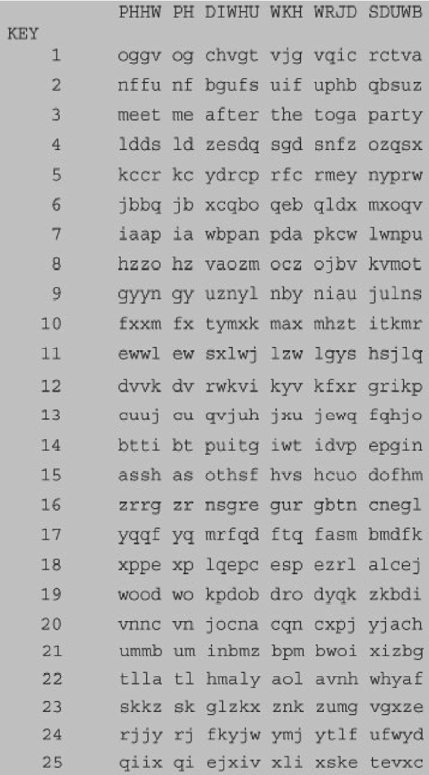
Cryptanalysis of Caesar Cipher
Brute-force attack is easily possible.
Need to try just 25 keys.

Slide 19
More Monoalphabetic Substitutions …
Shuffle the letters and map each plaintext letter to a different random ciphertext letter:
Plain letters:
Cipher letters:
Plaintext: ifwewishtoreplaceletters
Ciphertext: WIRFRWAJUHYFTSDVFSFUUFYA
+-------------------------+-------------------------+--------------------+
| A B C D E F G H I J K L M N O P Q R S T U V W X Y Z |
| D K V Q F I B J W P E S C X H T M Y A U O L R G Z N|
+-------------------------+-------------------------+--------------------+

Slide 20
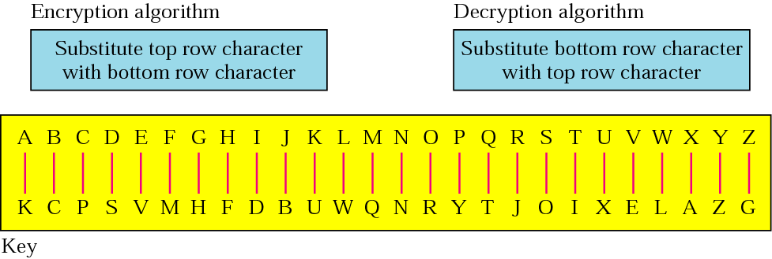
Monoalphabetic Cipher - example
1) pt : larger key size means greater security
CT : WKJHV JUVZO DGVQV KNOHJ VKIVJ OVPXJ DIZ
2) CT: SVOIJ RZIFV UVZKI IFVVN SRMIF VOVOO DRN
pt : destroy the key at the end of the session

Slide 21
Monoalphabetic Cipher Security
What does a key look like?
Now we have a total of 26! = 4 x 10²⁶ keys.
With so many keys, it is secure against brute-force attacks.
But not secure against some cryptanalytic attacks.
Problem is language characteristics.

Slide 22
Language Statistics and Cryptanalysis
Human languages are not random.
Letters are not equally frequently used.
In English, E is by far the most common letter, followed by T, R, N, I, O, A, S.
Other letters like Z, J, K, Q, X are fairly rare.
There are tables of single, double & triple letter frequencies for various languages

Slide 23
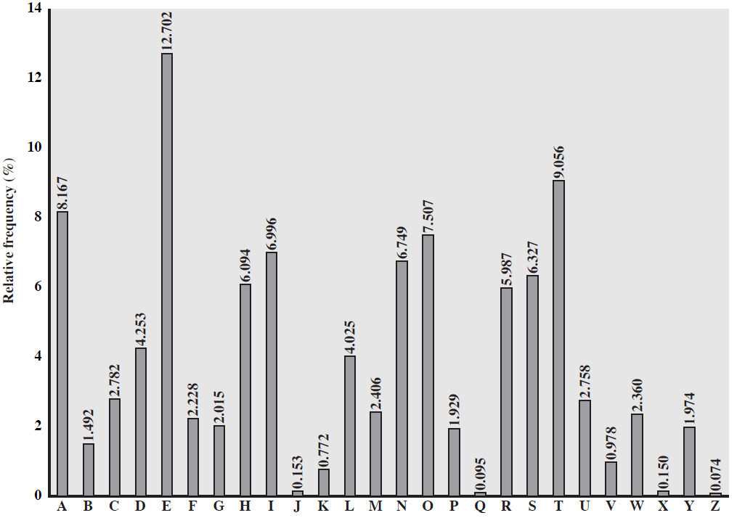
English Letter Frequencies

Slide 24
Statistics for double & triple letters
In decreasing order of frequency
Double letters (Digram frequency):
th he an in er re es on, …
Triple letters (Trigram frequency):
the and ent ion tio for nde, …

Slide 25
Classical Substitution Ciphers
Letters/bits of plaintext are replaced by other letters/bits.
Categorized as:
Monoalphabetic Ciphers
Homophonic Ciphers
Polyalphabetic Ciphers
Polygram Ciphers

Slide 26
Homophonic Ciphers
Replacing each letter with a variety of substitutes (homophones) where a homophone is used in rotation or chosen randomly.
The number of potential substitutes are proportional to the frequency of the letter.

Slide 27
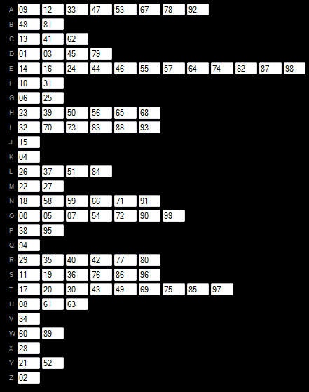
Example
pt: defending against frequency analysis attacks
CT: 45 14 31 87 66 01 73 59 25 09 06 78 88 71 11 49 10 40 98 94 63 46 58 41 52 12 58 53 26 21 19 73 36 33 20 69 67 62 04 76

